Slide 1
The Islamic Republic of Iran
Can theocracy and
democracy co-exist?

Slide 2
Why do we study Iran?
Iran is in the Middle East and it’s predominantly Muslim.
Iran’s government is ruled by clerics, according to their interpretation of the Koran.
Iran’s government was established in 1979 after the Islamic Revolution, making it a bit of an experiment in government

Slide 3
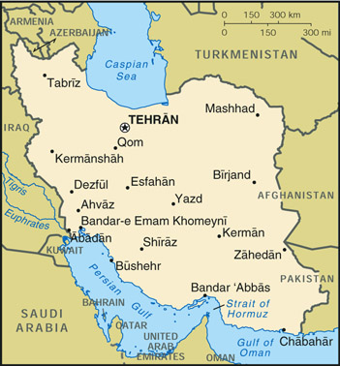
What do we need to know?
Geography ?
Dry; Vulnerable to Invasion
Economy?
Oil (2nd largest in Middle East, 4th largest in the world)
Religion?
Shi’ite vs. Sunni controversy
Population/Statistics
68 million; 83% literacy rate (for men); life expectancy - 71 years; 67% urbanization; Persian culture and language.
Notes:
Saudi Arabia;
Iraq;
Canada;
Iran;
Kuwait;
Venezuela;
UAE;
Russia;
11. Nigeria;

Slide 4
Political Culture
Authoritarianism
Union of Political and Religious Ideology
Shi’ism – central importance
Escaped European colonization
Ancient Persian influence.

Slide 5
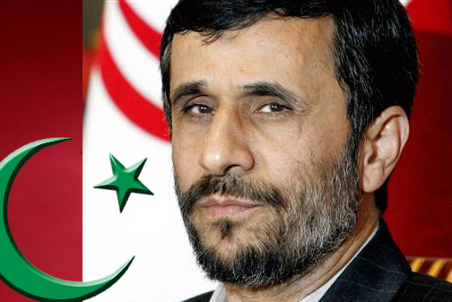
President – Mahmoud Ahmadinejad 2005 - present

Slide 6
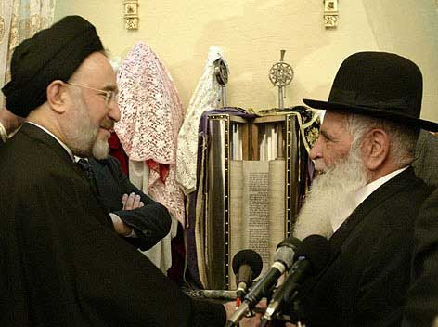
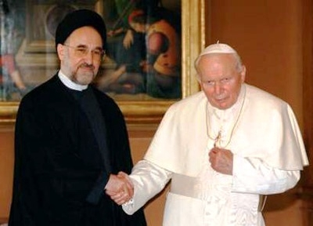
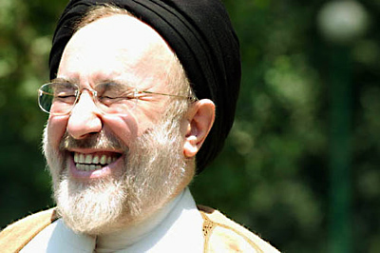
Mohammed Khatami: President 1997-2005

Slide 7
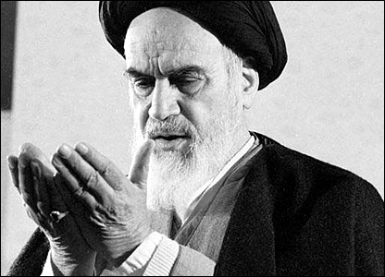
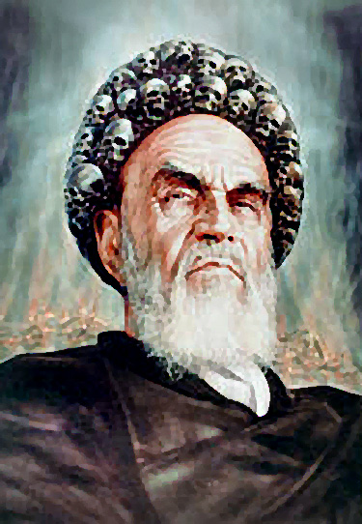
Ayatollah Ruhollah Khomenei (Supreme) Leader: 1979 - 1989

Slide 8
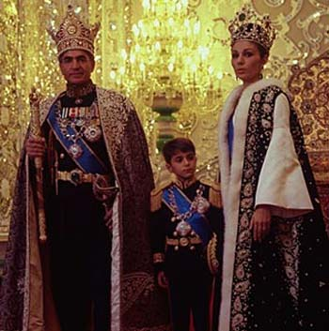
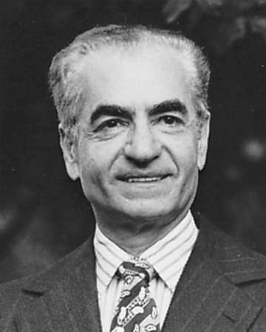
Mohammed Reza Shah King from 1941-1979

Slide 9
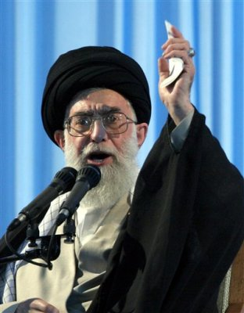
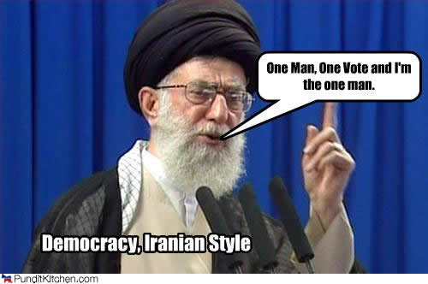
Ayatollah Ali Khamenei (Supreme) Leader: 1989 - present

Slide 10
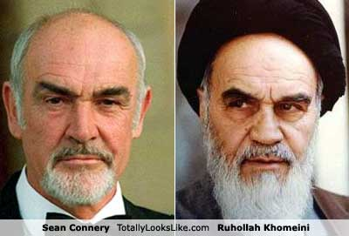

Slide 11
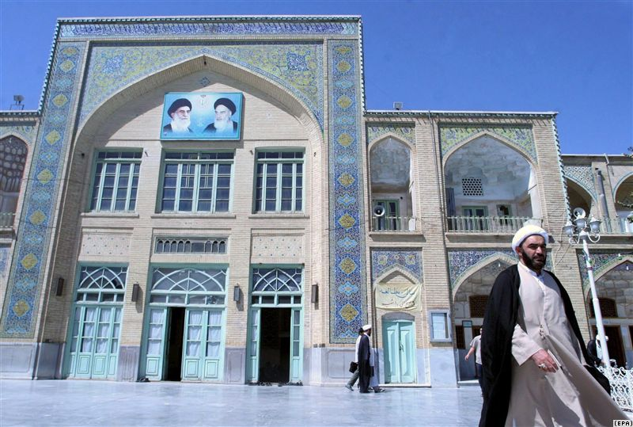
Background to Political Structure
Jurists guardianship
Clerics should rule because they are divinely appointed to guard both the law and people.
Khomeini popularized this idea and it serves as a foundation for the Iranian political system

Slide 12
Background to Political Structure
Democracy
Theocracy
The institutions and offices of government reflect both democratic and theocratic characteristics.

Slide 13
Background to Political Structure
Constitution
“The unique characteristic of this Revolution, as compared with other Iranian movements of the last century, is that it is religious and Islamic.” from the Preamble to the Iranian Constitution
Amended in 1989 and approved by referendum
There is a constitution but it is not the final authority…what do you think is?

Slide 14
Branches of Government
Judicial
Executive
Legislative

Slide 15
Background to Political Structure
The Judicial branch of the government is given central importance in the Constitution
Why do you think this is?

Slide 16
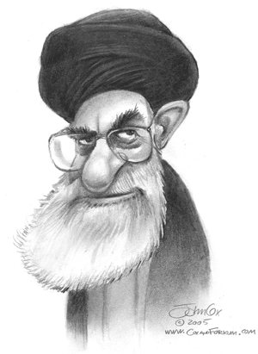
Supreme Leader
Appointed by the Assembly of Religious Experts
HE CAN…
Eliminate Presidential Candidates
Can Dismiss the President
Command the Armed Forces/Declare War
Appoint/Remove Judges
Nominate 6 members of the Guardian Council
Mediates between government branches

Slide 17
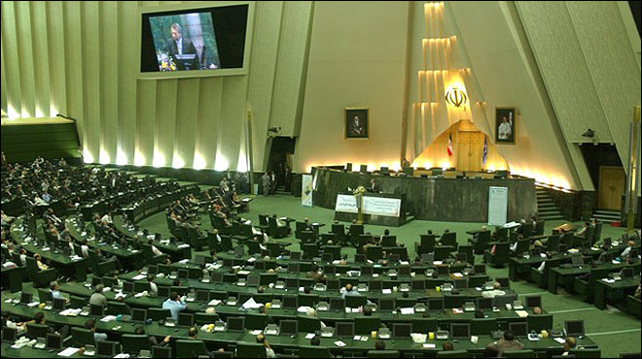
Majles
Elected to a 4-year term
Iran is a unicameral legislature (kind of…)
Makes laws (w/ Guardian Council approval)
Interprets laws (as long they don’t contradict)
Appoints 6 of the 12 Guardian Council members (from a list chosen by the Chief Judge).
Investigates complaints about government
Approves budgets

Slide 18
Guardian Council
12 Clerics – 6 chosen by Leader, 6 by Chief Judge (and then approved by the Majles)
They can…
Approve or reject bills passed by the Majles.
Their role is to make sure that all law is consistent with shari’a (law derived from the Koran)

Slide 19
Expediency Council
32 Members – all appointed by the Supreme Leader
The Expediency Council was created by Khomeini to resolve disputes b/w the Guardian Council and the Majles because they were always fighting.
What do you think they were fighting about?

Slide 20
Assembly of Religious Experts
86 Elected Members
Responsible for interpreting the Constitution
Appoints (and can remove) the Supreme Leader
All candidates must be approved by the Guardian Council
Until recently, each candidate had to be a cleric with a master’s degree in Islamic theology. Now qualifications are reduced but still very high.

Slide 21
President
Elected to 4 year terms, maximum 2 terms
Must be a “pious” Shi’ia Muslim faithful to the Islamic Republic
Highest official in government after the S. Leader
Oversees the economy
Signs treaties, laws, agreements
Selects the Vice President and a cabinet
Executes policies
Proposes legislation

Slide 22
Judiciary
Two kinds of law…
1. Shari’a – centuries old, intended to embody the essence of Mohammed; sacred. Interpreted by S. Leader, Guardian Council, Assembly of R. Experts
2. Qanun – laws passed by Majles; not sacred.
The Chief Judge – Appointed by the S. Leader
A strict interpretation of Shari’a that as included stonings, public executions, and live burials.
Death sentence for adultery, drunkenness, drugs
Today, the court imposes modern penalties such as imprisonment, fines, etc.

Slide 23
Guardian Council
Supreme Leader
Assembly of Religious Experts
Expediency
Council
Majles
Electorate
President
Judiciary

Slide 24
