Slide 1
The Peoples Republic of China

Slide 2
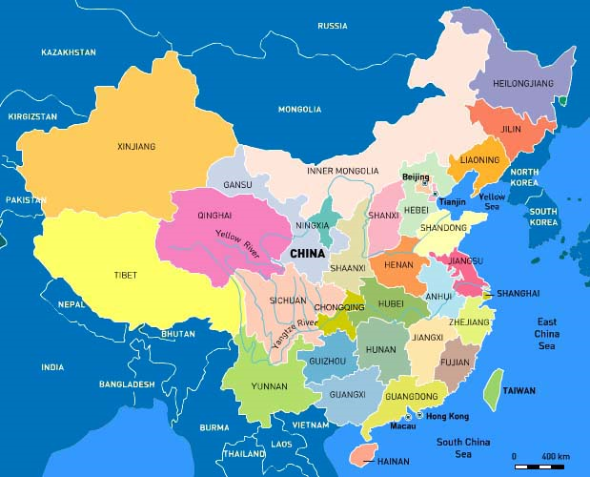
Geography

Slide 3
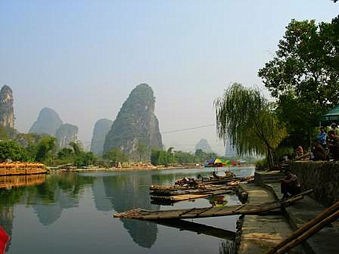
Geography
Access to warm water ports
Large navigable rivers
Major splits climate differences between North/South
Isolation of Western China
Mountains, deserts, and oceans that separate China.

Slide 4
Historical Eras
Dynastic Rule
Resistance to Imperialism (19th Century)
Created a spirit of nationalism and suspicion of capitalist countries
Maoism – Emphasizing the strength of the Peasant
Collectivism; Struggle & Activism; Mass Line; Egalitarianism; Self-Reliance
Deng Xiaoping Theory
“It doesn’t matter whether a cat is white or black, as long as it catches mice.”
Market Capitalism! No individual freedoms! No democracy!

Slide 5
Historical Influences
Long periods of Rule by family
Times of Chaos
Challenge and overthrow by new dynasty
Dynastic
Cycles

Slide 6
Historical Influences
Authoritarian Power
The Chinese have always been subjects, not participants
Confucianism
Order & harmony; submission to the emperor; emperor responsible to fulfill his duty properly
Bureaucratic heirarchy based on scholarship
On the basis of Confucianist examinations
The concept of Middle Kingdom”
Outsiders viewed as barbarians.
20th Century Communist ideology
Maoism with its emphasis on egalitarianism.

Slide 7
Political Economy & Development
“One of the century’s greatest economic miracles.”
“One of the biggest improvements in human welfare anywhere at any time.” (When China Wakes)
2nd largest economy in the world
Per capita income has increased 20x (rural) and 15x (urban) in the last 30 years
300 million people have been lifted from poverty.

Slide 8
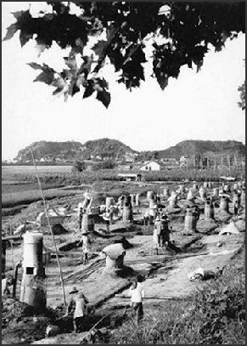
Political Economy & Development
In 1949, the first order of business was reviving the devastated economy.
Command economy – The state took over.
Five –Year Plan
Progress, but…
Backyard Furnace
Over 1 million furnaces were put in villages so that the peasants could produce like the big factories in the city.

Slide 9
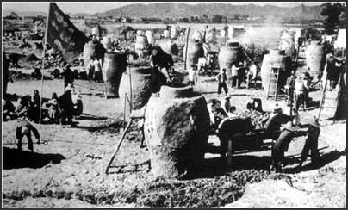
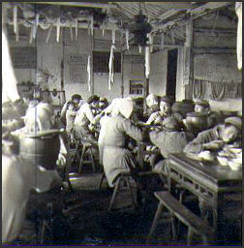
Political Economy & Development
The results…not so good
Wasted resources
Inefficiency
Poor management
30-40 million died in famine
However, under Mao…
Industrialization
Better health
Increased literacy

Slide 10
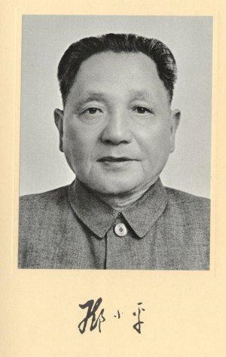
Political Economy & Development
China Goes to Market
“It doesn’t matter whether a cat is black or white, as long as it catches mice.”
This statement made Deng a victim of the Cultural Revolution, but a hero of modern China.
Deng’s reforms revolutionized the economy and redefined socialism and the Communist Party in China.

Slide 11
Political Economy & Development
1978 – State Owned Enterprises (SOE’s) – 100,000
2008 – 25,000
1978 – SOE’s generated 80% of GDP
2003 – 17% of GDP
The private sector is growing, the state owned sector is shrinking.
Prices are set by supply and demand, not a central planning agency.

Slide 12
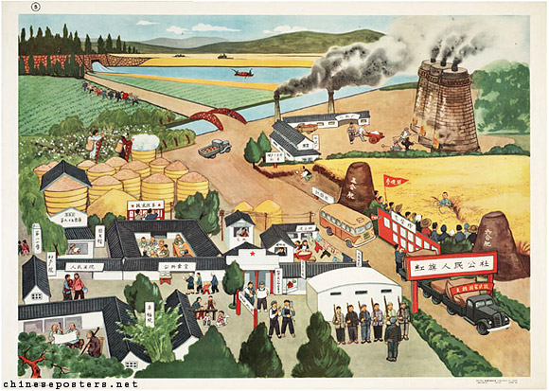
Political Economy & Development
Remaking the Rural areas
During the GLF, the rural farmers were organized into “people’s communes.” This proved to be a weak system.
Deng replaced this system with the “household responsibility system”
But the real change was brought by the TVE’s or the “township and village enterprises.”
There are now over 20 million TVE’s employing more than 130 m. people

Slide 13
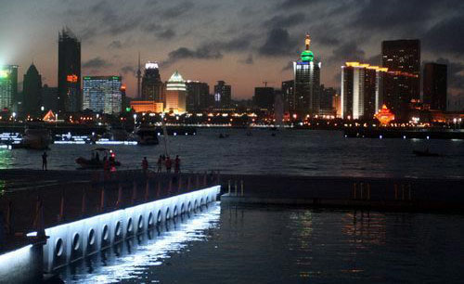
Political Economy & Development
Special Economic Zones (SEZ’s)
Tax breaks and other incentives to attract FDI. This began in 1979.

Slide 14
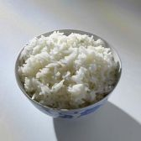
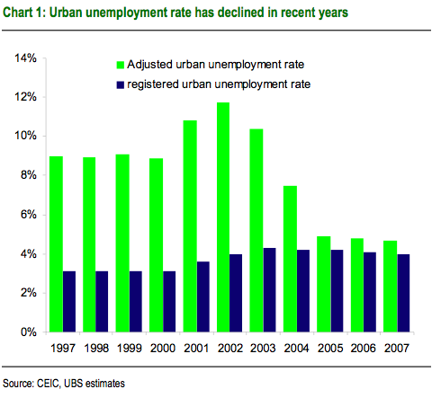
Economic Problems
No more iron rice bowl…
Unemployment is on the increase.
“floating population” refers to the migrant populations growing in the cities. New problems are emerging that could lead to greater social unrest.
Pollution
Product Safety

Slide 15
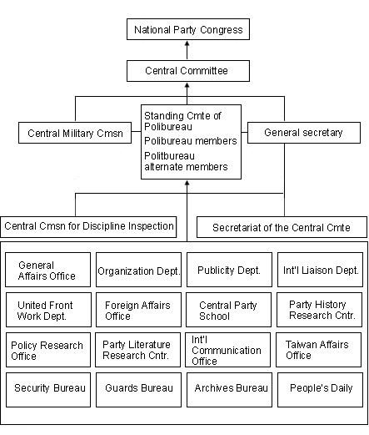
Communist Party Structure

Slide 16
China in Numbers (2008 Data)
30,000: The expected number of Chinese MBA graduates in 2008. The number in 1998: 0
5.7 million: Students graduated from Chinese universities in 2007 (compared with 270,000 in 1977)
30: Number of nuclear power plants being built in China
500: The number of coal-fired power plants China plans to build in the next decade
10 million: The estimated number of Chinese people who have no electricity
97: New airports to be built in the next 12 years, bringing the total number to 244 by 2020
540 million: Number of mobile phone users in China, with an increase of 44 million in the past six months
180: The number of foreign press correspondents arrested or harassed in 2007
67: The percentage of journalists who replied "no" when asked in a survey by the Foreign Correspondents Club of China if they believed Beijing had kept its promise to give foreign media "complete freedom of reporting" in the run-up to the Olympics. Only 8.6 per cent said "yes"

Slide 17
33: The number of Chinese journalists thought to be held in prisons in 2008
95: The estimated percentage of DVDs sold in China that are fake. Uncensored foreign films are widely available from 50p
20: The approximate number of foreign films passed by Chinese censors each year for screening in cinemas. Banned films have included 'Ben Hur' (for its depiction of religion), 'Brokeback Mountain' (for its homosexuality) and the 'Borat' film (for its depiction of, among other things, incest).
Passed films are often subject to further editing. Examples include the deletion of scenes showing hanging laundry in Shanghai in 'Mission: Impossible III' and the removal of footage containing Chow Yun-Fat that 'vilifies and humiliates the Chinese' in 'Pirates of the Caribbean: At World's End'
160: Cities in China with populations that exceed a million. In the USA there are nine; in the UK just two
80: Percentage of the world's zips produced in factories in the Zhejiang Province city of Qiaotou (amounting to 124,000 miles of zip each year, or enough to stretch half way to the moon). Qiaotou also produces 60 per cent of the world's buttons (15 billion a year), while nearby Datang makes a third of the world's socks. As many as 80 per cent of the world's toys are made in China, which boasts more than 10,000 toy factories

Slide 18
21 million: The number of Chinese-made toys recalled last year by the US toy company Mattel
0: Miles of motorway in 1988
30,000: Miles of motorway today
6.3 million: The number of passenger cars registered in 2007 (compared with 2.3 million in 2004). More than 1,000 new private cars hit the roads every day in Beijing alone
68: The number of crimes thought to be punishable by death in China, including non-violent offences such as tax fraud, embezzlement and the taking of bribes
350 million: The number of Chinese people who smoke (a third of the world’s smokers). Around a million people a year are thought to die from smoking-related diseases
240bn yuan: (£17.3bn) The estimated amount earned by the Chinese government in tobacco taxes in 2005
1.3 billion: China’s population. The country accounts for one in five people in the world 400 million

Slide 19
The estimated number of births prevented by China’s one-child policy, introduced in 1979
22: The number of suicides per 100,000 people, about 50 per cent higher than the global average. Suicide is the fifth most common cause of death in China, and the first among people aged between 20 and 35
700,000: The number of people living with HIV or Aids in China. The UN has warned China it could have 10 million cases by 2010 unless action is taken
45 billion: Estimated number of chopsticks China produces every year, the majority of them disposable. In 2006, Beijing introduced a five per cent tax on disposable wooden chopsticks in an attempt to help save the country’s forests
30: The number of different animal penises on the menu at Guolizhuang, Beijing’s ‘penis emporium’. A yak’s costs about £15, while a tiger’s (which must be pre-ordered) will set you back £3,000

